Slide 1
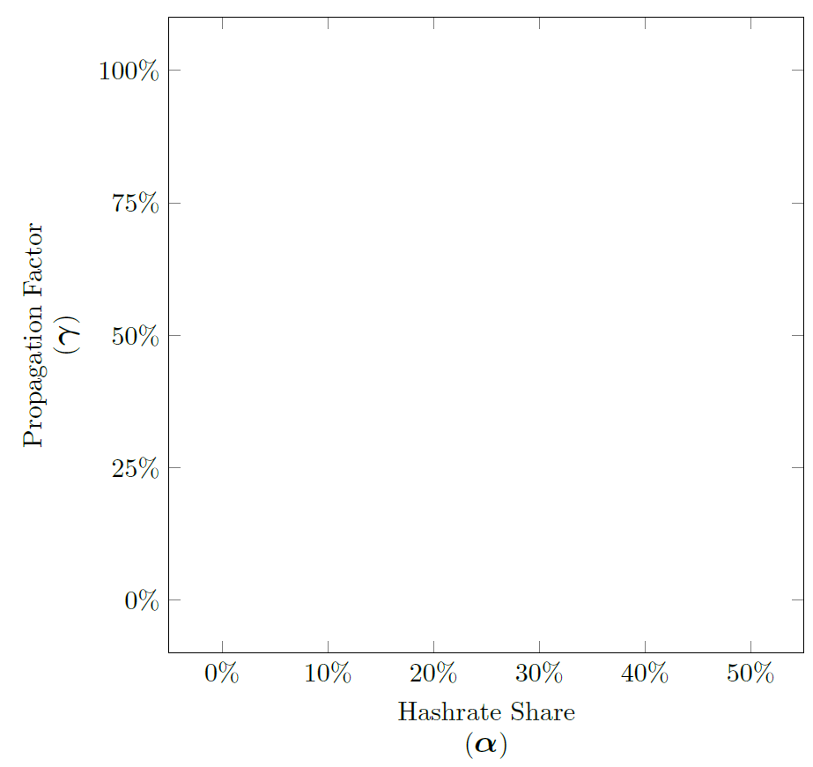

H
S
L
T2
T3
T4
E
Propagation Factor
(γ)
Hashrate Share
(α)

Slide 2
H
S
L
T2
T3
T4
E
Apparent Hashrate as the 3rd dimension gives us an intuition into why a strategy wins!
Propagation Factor
(γ)
Hashrate Share
(α)

Slide 3







H
S
L
T2
T3
T4
E
H
S
L
T2
T3
T4
E
Apparent Hashrate as the 3rd dimension gives us an intuition into why a strategy wins!
Propagation Factor
(γ)
Hashrate Share
(α)
H S
H L
H T2
H T3
H T4
H E

Slide 4







H
S
L
T2
T3
T4
E
H
S
L
T2
T3
T4
E
H S
H L
H T2
H T3
H T4
H E

Slide 5








H
S
L
T2
T3
T4
E
Higher surface means higher Apparent Hashrate!
γ
α’
α

Slide 6

H
S
L
T2
T3
T4
E

Slide 7
H
S
L
T2
T3
T4
E
Propagation Factor
(γ)
Hashrate Share
(α)

